Slide 1
Gesture-Based Human-Computer Interaction System Using OpenCV, MediaPipe and Palm’s text-bison-001
Presented by:
III DS-B
Y. Lasya
S. Neetha Reddy
M. Navya
K. Navya

Slide 2
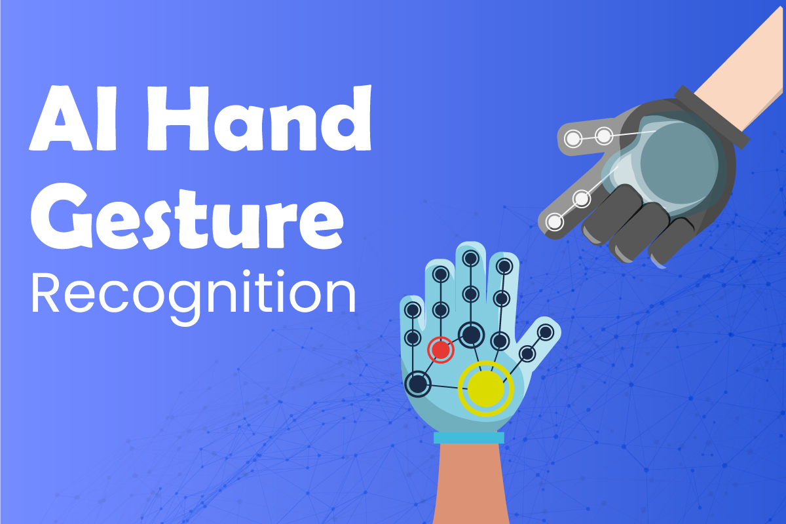
Introduction to Hand Gestures GENAI
Hand gesture recognition is a critical aspect of human-computer interaction.
It enables devices to interpret and respond to user gestures in real-time.
OpenCV provides robust tools for image processing, making it ideal for gesture recognition applications.
Notes:
Image source: https://blog.learningbix.com

Slide 3
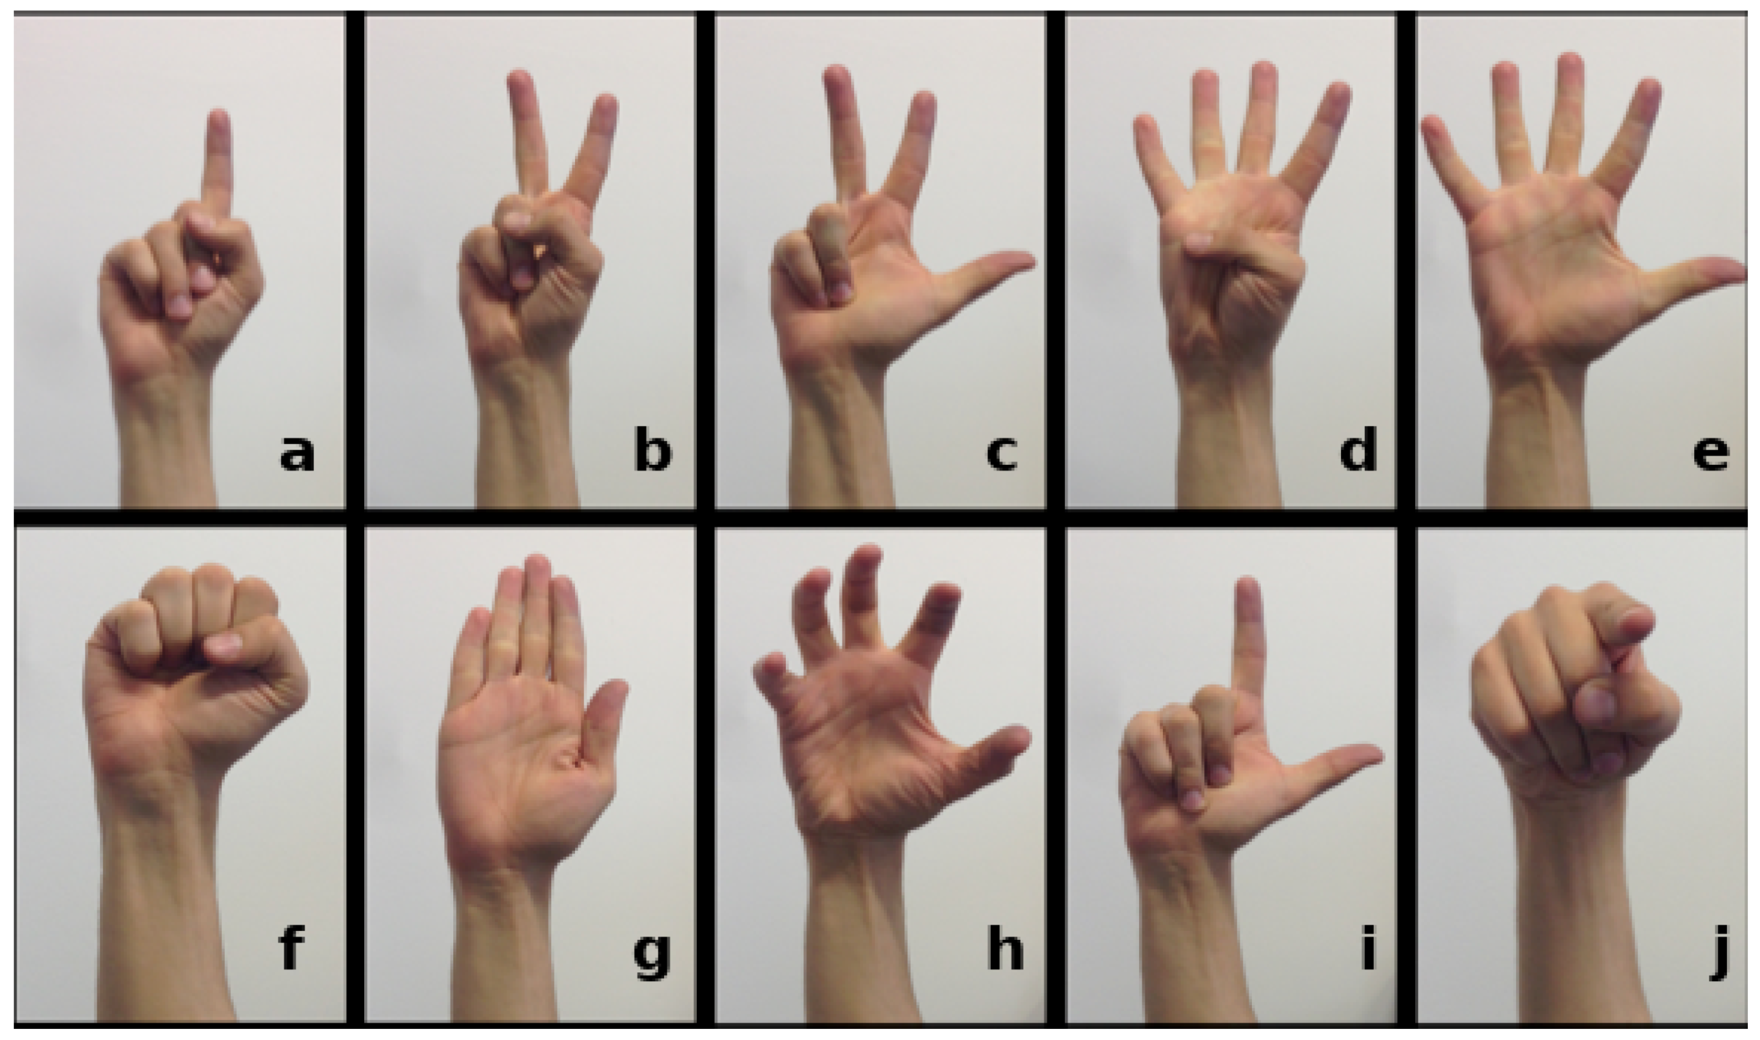
Importance of Hand Gesture Recognition
Hand gestures can enhance accessibility for individuals with disabilities.
They facilitate a more natural interaction between humans and machines.
Gesture recognition is becoming increasingly popular in areas like gaming and virtual reality.
Notes:
Image source: https://pub.mdpi-res.com

Slide 4
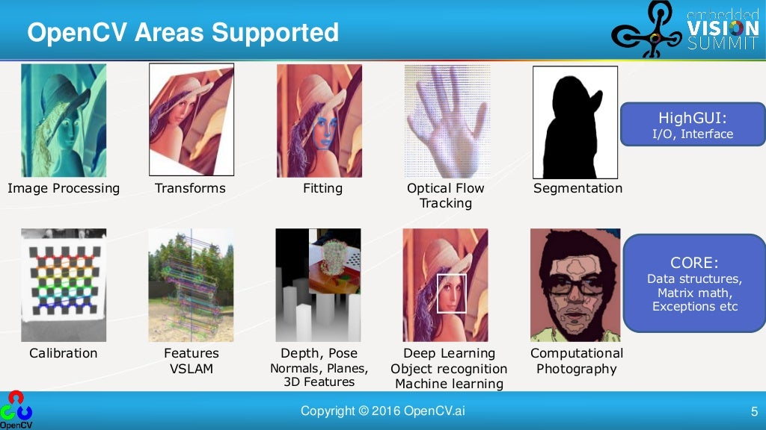
Overview of OpenCV
OpenCV is an open-source computer vision library that supports real-time image processing.
It offers a wide variety of functions for image manipulation and analysis.
The library is compatible with multiple programming languages, including Python and C++.
Notes:
Image source: https://image.slidesharecdn.com

Slide 5
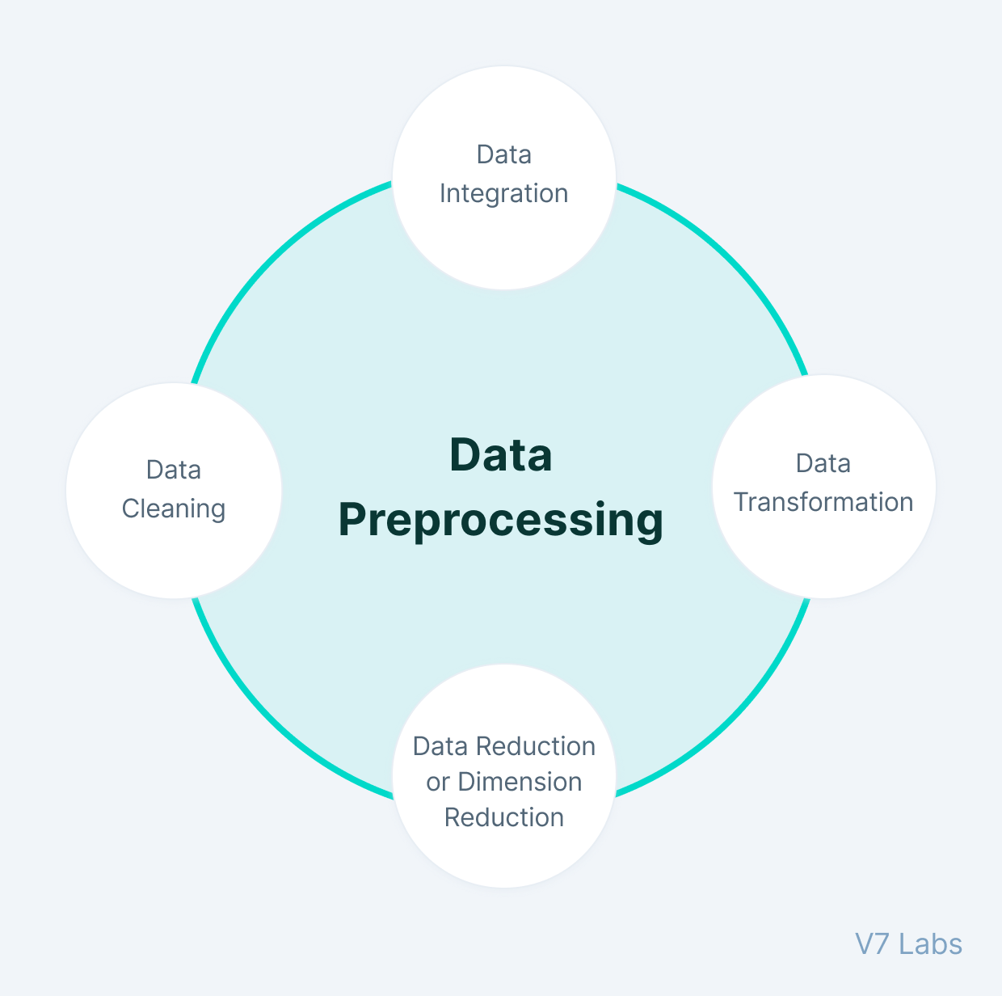
Key Techniques in Gesture Recognition
Image capture and preprocessing are essential steps in recognizing hand gestures.
Machine learning algorithms, such as neural networks, can be trained to identify specific gestures.
OpenCV provides tools for contour detection, which helps in identifying hand shapes effectively.
Notes:
Image source: https://assets-global.website-files.com

Slide 6
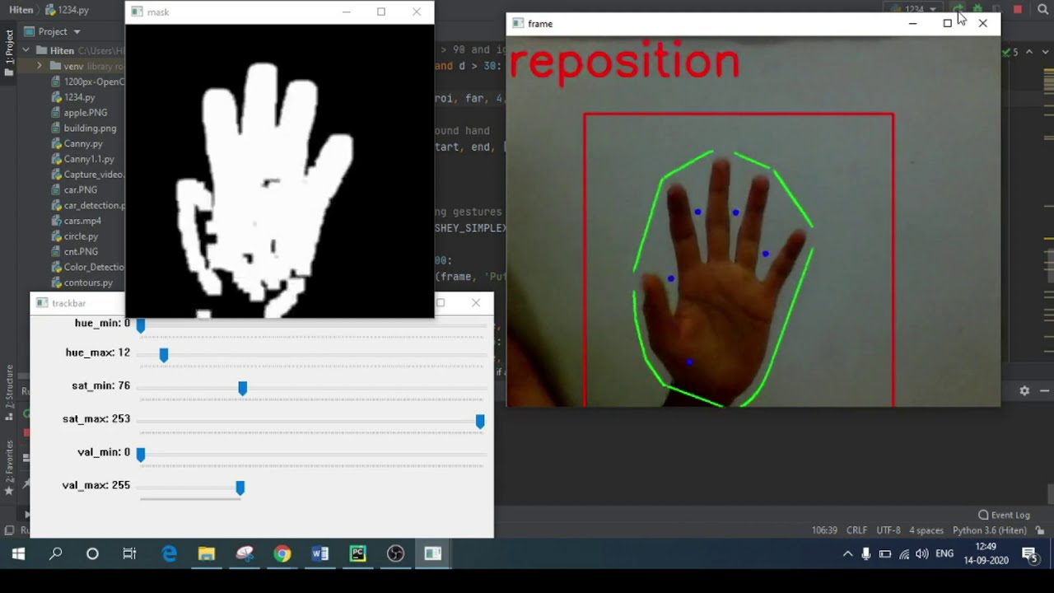
Implementing Hand Gesture Recognition with OpenCV
The first step involves setting up the OpenCV environment and importing necessary libraries.
Next, video capture techniques are employed to acquire real-time hand gesture data.
Finally, the gesture recognition model can be tested and refined for accuracy and performance.
Notes:
Image source: https://i.ytimg.com

Slide 7
Applications and Future Directions
Hand gesture recognition technology has applications in smart homes and robotics.
It is also being integrated into augmented reality systems for interactive experiences.
Future advancements may include improved accuracy and responsiveness through deep learning techniques.
This presentation provides a structured overview of Hand Gesture Recognition using OpenCV, highlighting its significance, techniques, implementation, and future prospects.
Notes:
Image source: https://terabee.b-cdn.net

Slide 8
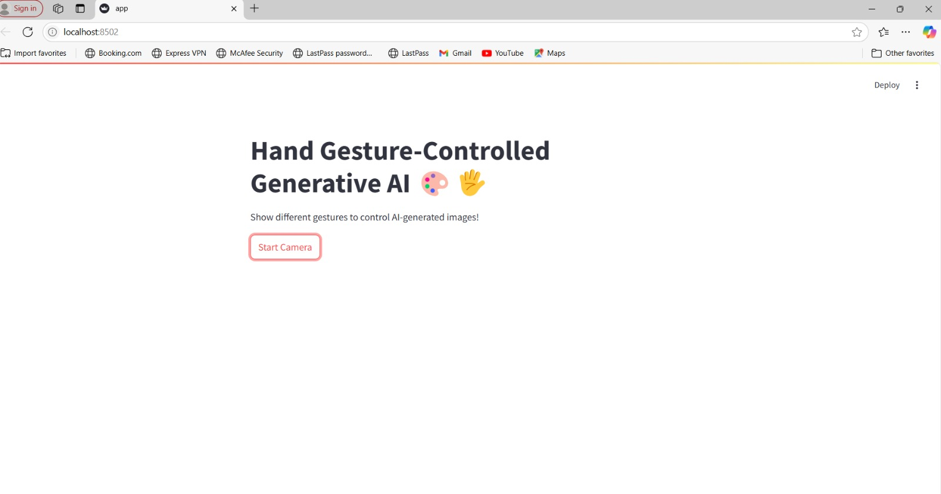

Slide 9
Conclusion
Using OpenCV and Generative AI for hand gesture recognition offers a promising path for intuitive human-computer interaction, enabling applications like controlling devices or creating virtual interfaces with hand gestures, as demonstrated by projects like virtual calculators.

